Slide 1
ALGORITHMS
MOVIE RECOMMENDATION
SYSTEM
By: Shivam Joshi

Slide 2
Problem statement
Recommendation for a movie is important in our public life because of its ability to provide improved entertainment. Such a system can suggest a set of movies for users based on their preferences, or movie ratings. Although a set of movie recommendation programs have been proposed, many of them are not able to recommend a movie to existing users successfully or to a new user in any way. In this project we are proposing a movie recommendation system with the ability to recommend movies to a new user and others. A database of movie information to gather all the important information, such as thunderstorms and attractions, needed to be commended.

Slide 3
methodology
To implement the above problem statement I used three algorithms which are -
Content based algorithm
kNN algorithm
User-user based algorithm

Slide 4
Content based algorithm
I used two dataset for this algorithm tmdb_5000_movies and tmdb_5000_credits
I merged two dataset and created a new data set and the extracting the following columns suck as genres, keyword, overview, cast and crew(director)
I worked on each column cleared the excess portions and got a clean dataset
After this I merged the genres, keyword, overview, cast and crew(director) columns.

Slide 5
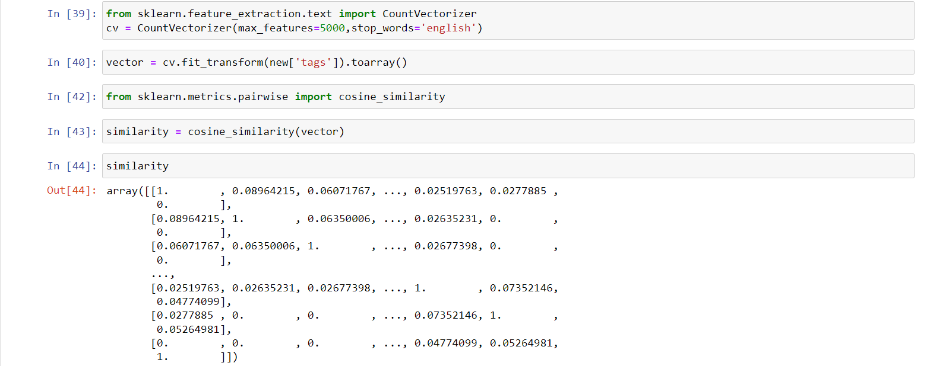
Then I created a similarity variable containing similarity between the movies

Slide 6
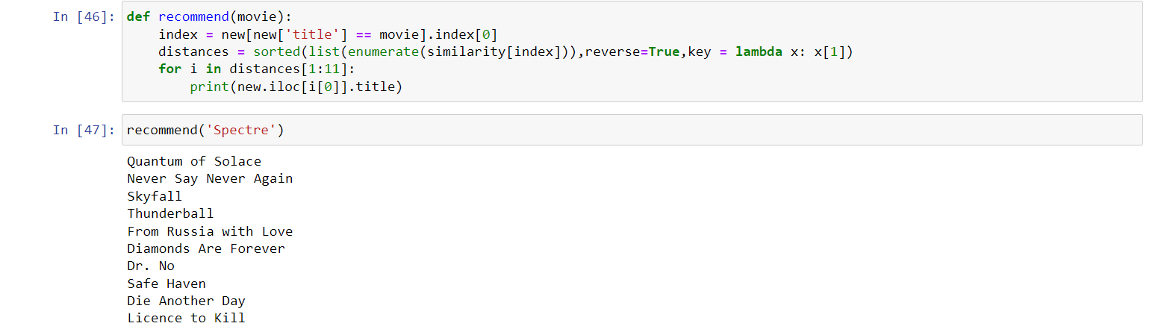
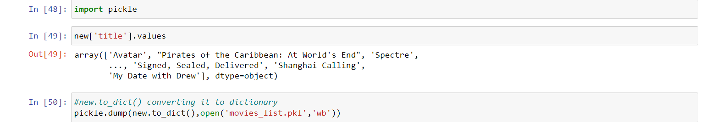
After finding out similarity we write a function recommend that will recommend 10 movies which will be similar to the one we have entered.
Then we import pickles to dumb our movie dataset so we can work on it in frontend

Slide 7
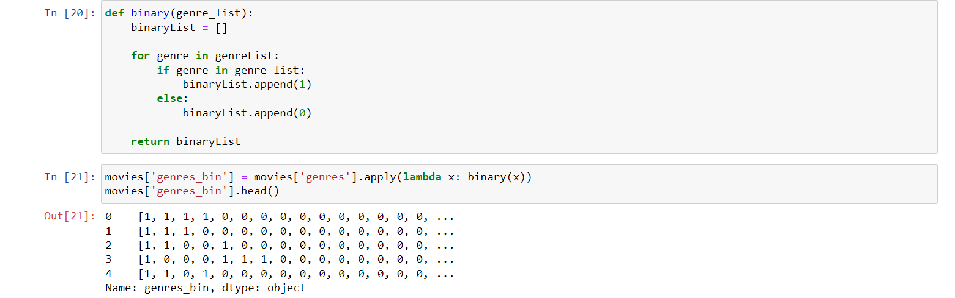
KNN BASED ALGORITHM
I used two dataset for this algorithm tmdb_5000_movies and tmdb_5000_credits
Then I merged the two data set
Then I found out binary values for genres

Slide 8
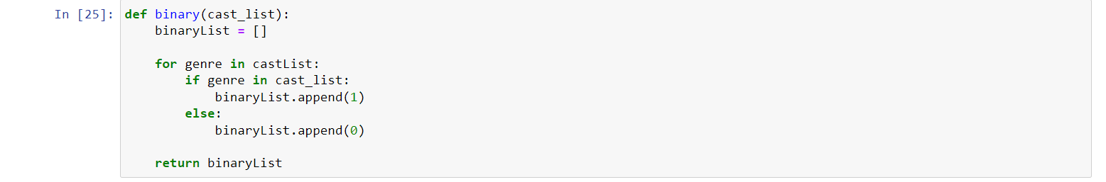
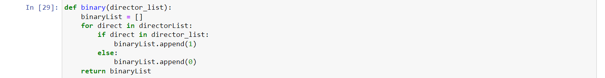
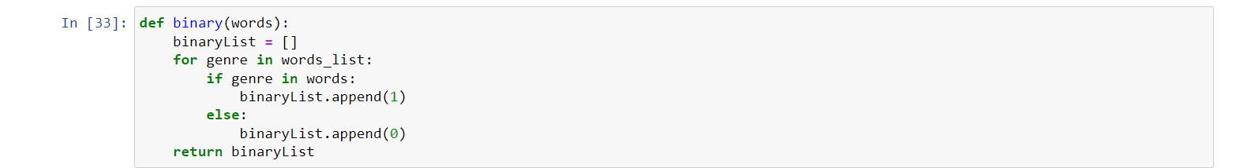
Then I found out binary values for cast
Then I found out binary values for director
Then I found out binary values for words

Slide 9
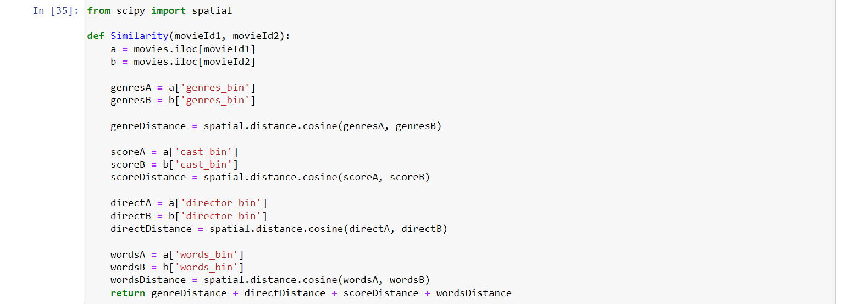
After finding binary we create a function similarity to check similarity between two movies

Slide 10
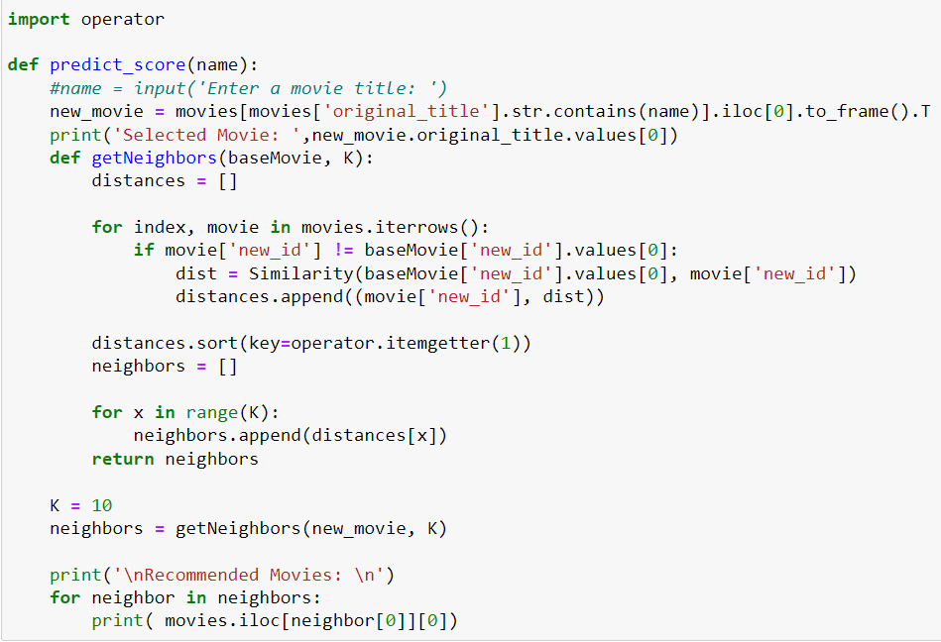
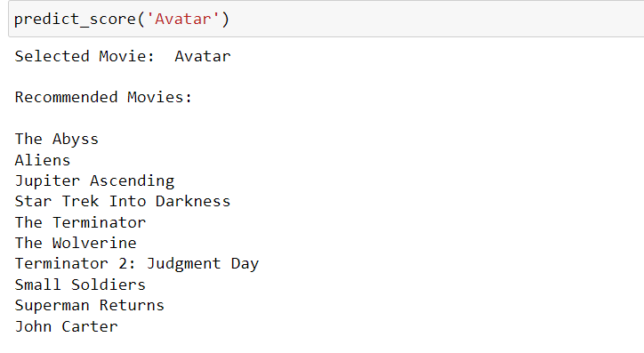
The we write a function for recommending the movie
Then we dump our dataset using pickle

Slide 11
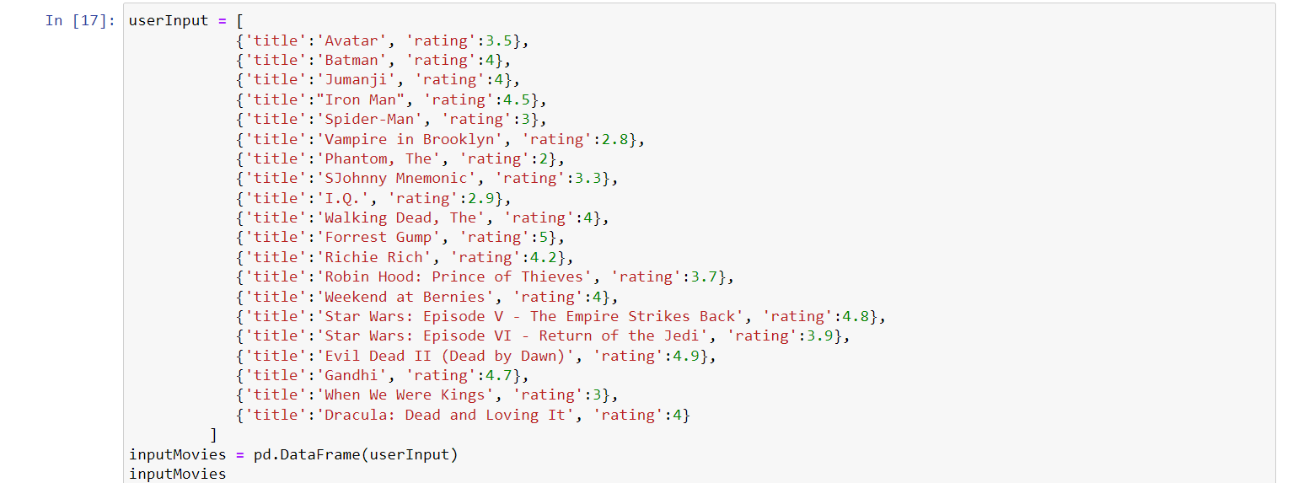
User-user based algorithm
Data set used is:
Then I created a data set for 1(one) user to get recommendation

Slide 12
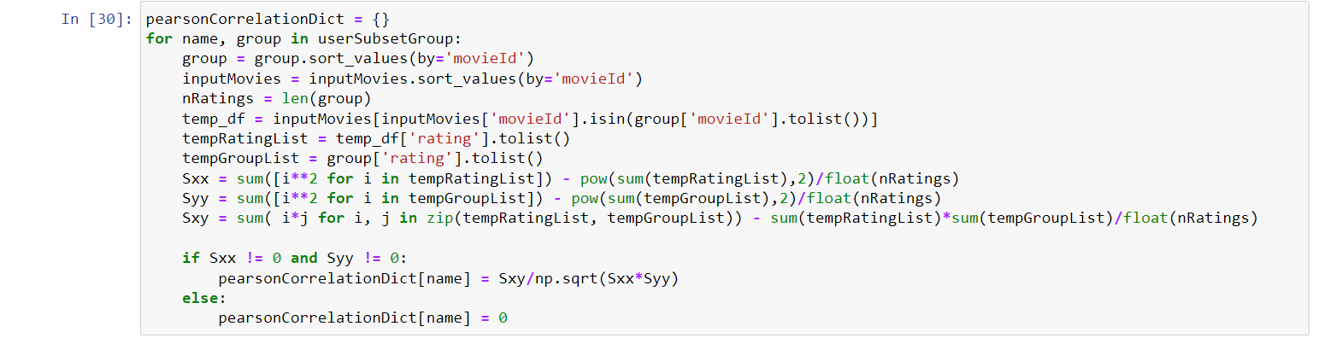
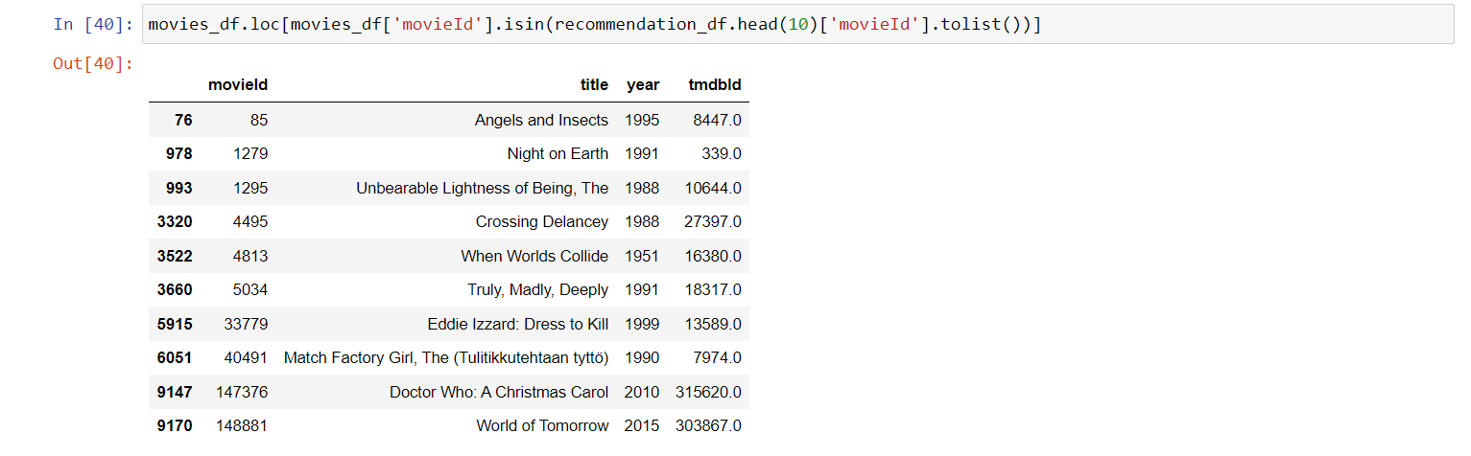
After creating the user dataset we used pearsonCorrelation to find the corelation
After this we found similar movies between two user and finally we recommend the movies

Slide 13
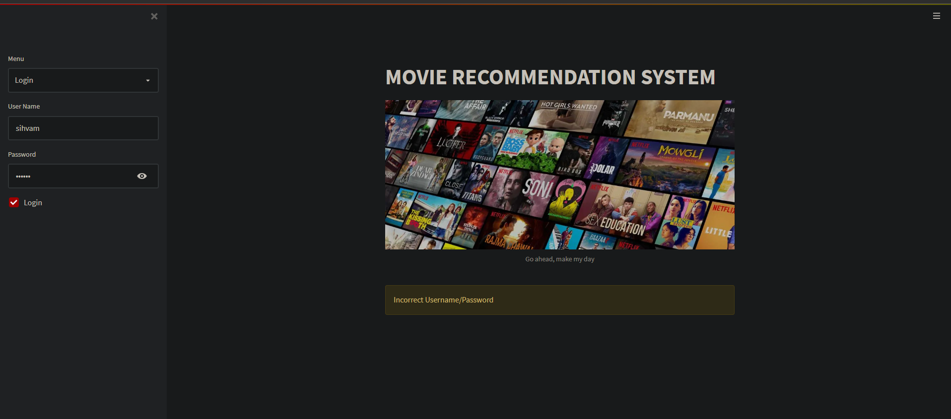
For frontend
I used streamlit library in python
I create a data base for users to store there username name password using hashlib and sqli3 liberaries
If user login and his/her data is not available in the database then it prefer them to signup

Slide 14
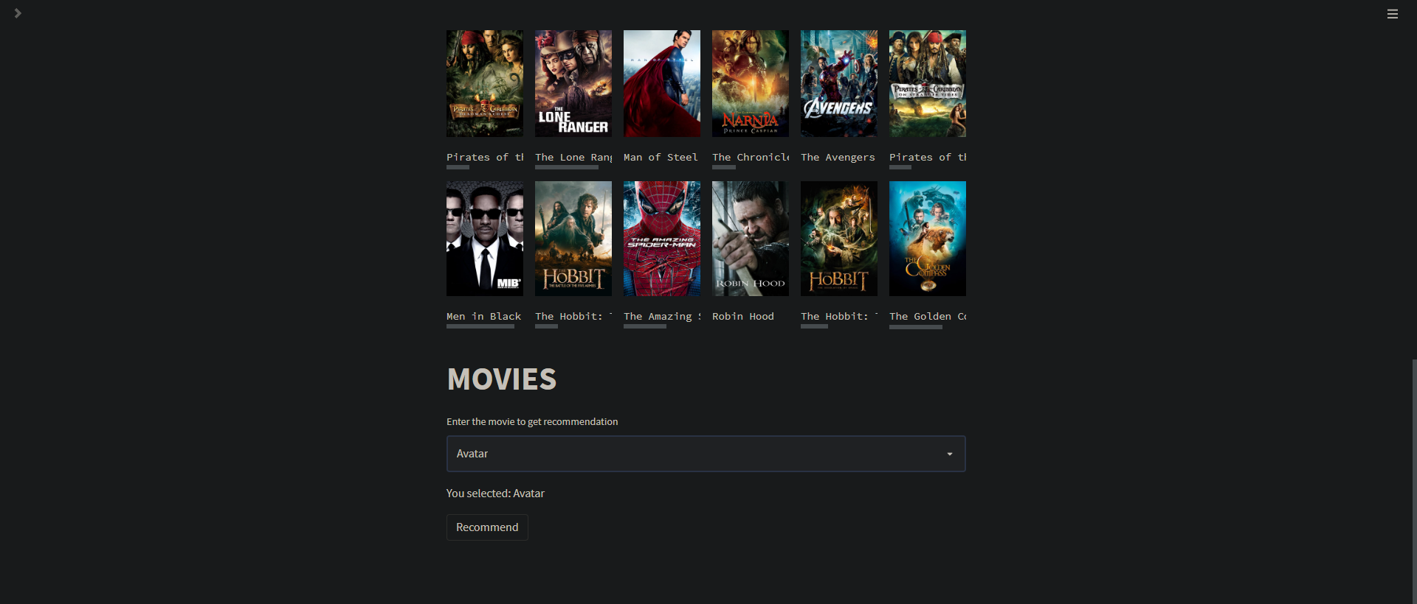
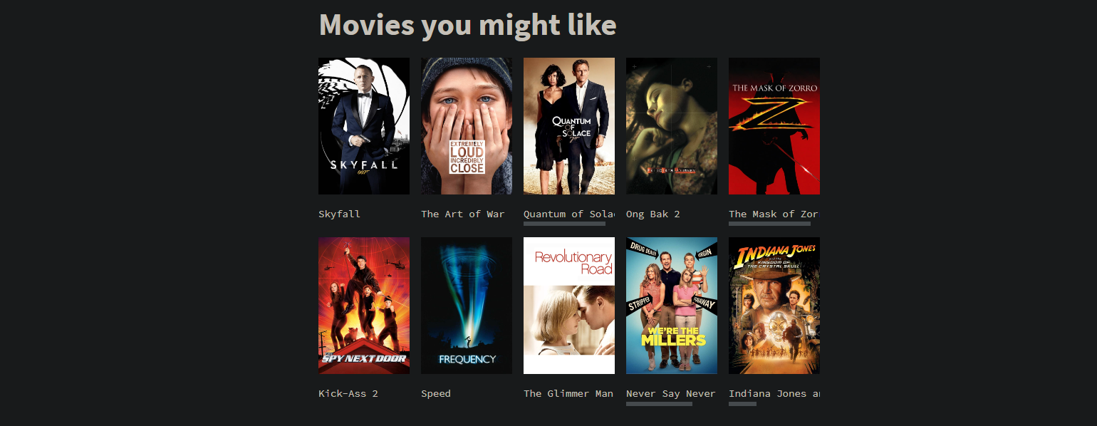
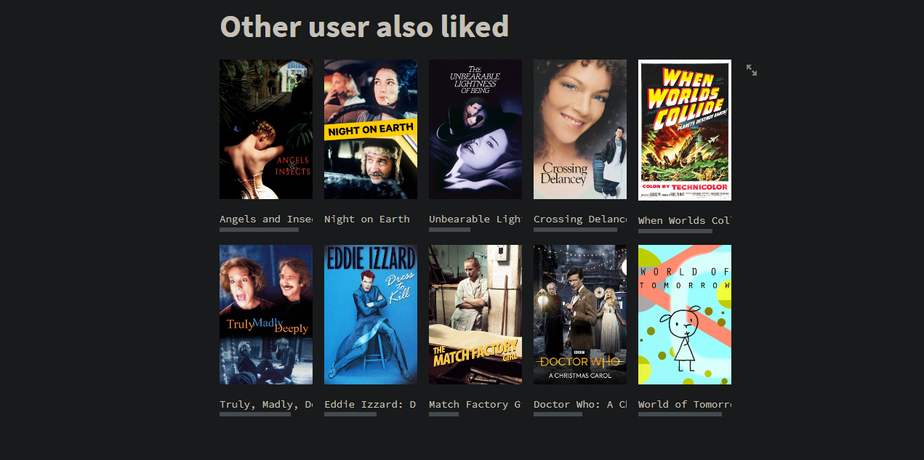
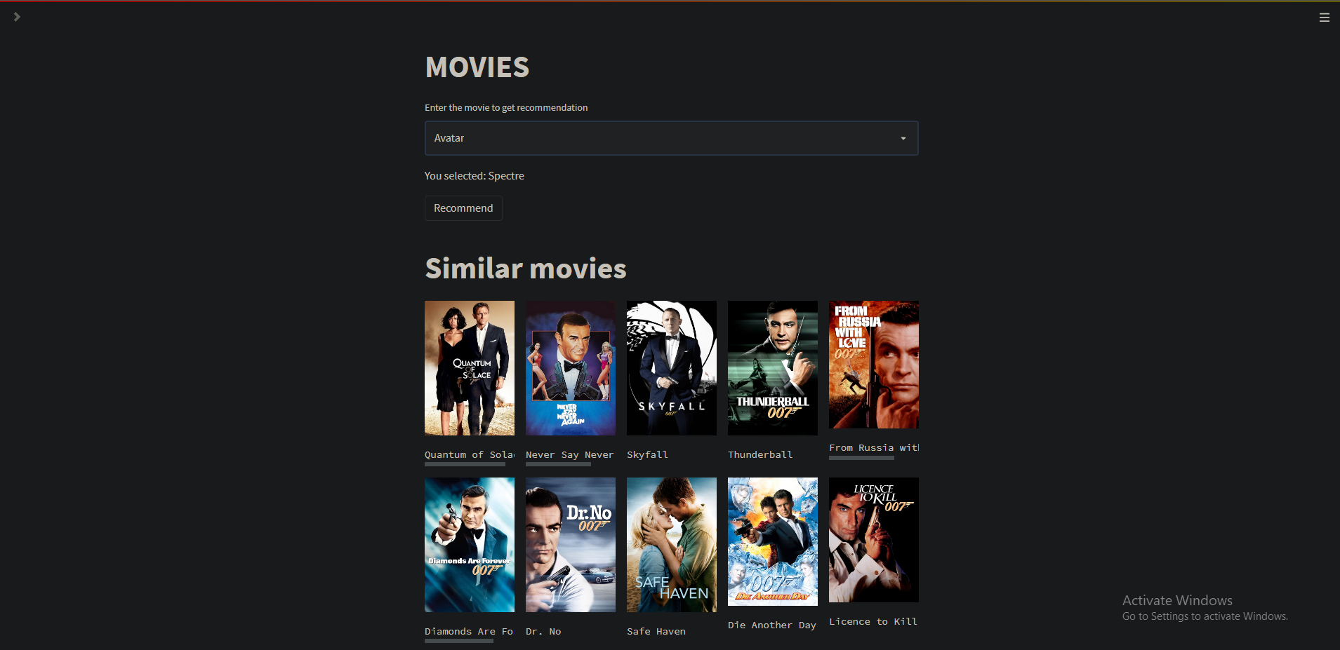
Sample:

Slide 15
requirements
Need to have knowledge of pycharm and jupyter notebook,.
Language used for backend python
Language used for frontend python.

Slide 16
tools
Major libraries used for backend ad frontend :
Pandas
Pickle
Numpy
json
Streamlit

Slide 17
Future scope
There are many things that can be added in this application to make it more efficient.
For user-user recommendation I only have dataset for 1 user I would like to add data of all the user which will login and then recommend them movie based on user-user algorithm.
I would like to add pages on my website
I would like to have links of movies on site as well

Slide 18
conclusion
The main idea of ​​the app is to allow the user to see movies similar to genres and also watch movies which other user like.
This site is working properly and have a login as well as signup available.
Each user can login into this site and enjoy the movie of there liking

Slide 19
bibliography
While creating of this project I have taken help from:
GitHub.com
Stackoverflow.com
Streamlit api reference

